Slide 1
Deep Observing Network
Matthias Lankhorst
OceanSITES Meeting, Southampton, 2016-04-27

Slide 2
Categories of deep T&S instruments
Challenge is to make more observations of deep T&S
Instrument Categories
Other parameters maybe later
Contribution to “Deep Ocean Observing Strategy” within the “Framework for Ocean Observing”
To be added to existing OceanSITES platforms that do not make such observations
OceanSITES instrument pool of SBE37
Coordinated approach to calibration and QC
Incentives for PIs: free instruments, free vendor calibrations
A. Existing, funded projects with own instruments
B1. PI dedicates existing instrument to newly occupied site
B2. PI purchases new instrument
B3. PI receives instrument from pool

Slide 3
Allocation of instruments
Each B1 and B2 category instrument earns one from the pool (for swap-out), plus calibrations
B3 also includes second instrument for swap, plus calibration
Serial numbers of all B to be tracked
Selecting sites needs approval process (proposal by PI, approval by Steering Team?)
Approval needed from PI / site operators
Commitment from PIs to provide consumables and handling
Commitment to provide data in a timely manner
Commitment to apply thorough QC and report long-term sensor behavior to vendor

Slide 4
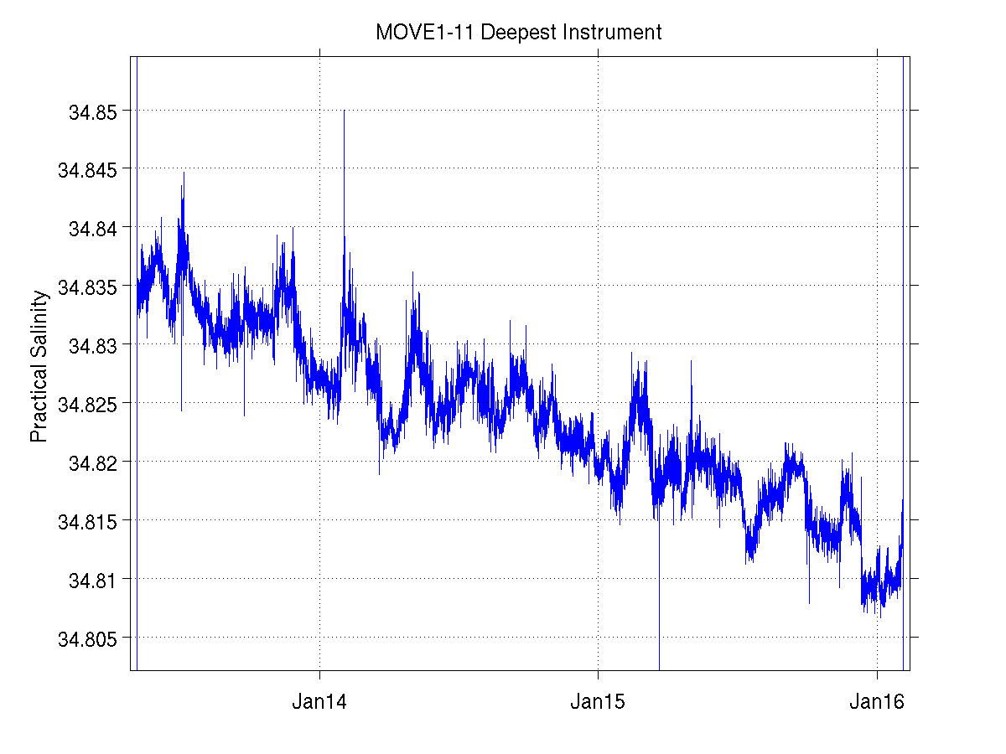
SBE 37-SM nominal accuracy specifications
Conductivity: 0.003 mS/cm
Temperature: 0.002 °C
Pressure: 7 dbar
Resulting salinity error:
  Due to C: 0.004
  Due to T: 0.002
  Due to P: 0.003
Signals not much bigger than sensor accuracy, not even including drift
Motivation for sensor/process improvement?

Slide 5
Data QC / Calibration
Compare SBE37 against reference (calibrated SBE 9/11 with salinity water samples)
  At deployment and recovery of mooring
  Either:
    Attach SBE37 to CTD rosette (preferred, since C, T, P independently compared)
    Deep CTD cast near mooring, then cross-compare in T-S space
    ...or both!
With that, can hope to reach nominal accuracy in situ
Learn about sensor behavior

Slide 6
What vendor could do
See separate write-up

